Slide 1


Parent Messaging System Online
Parent_School/College_Messaging_Workflow
Team Members:
Ruthwika Kumari CH
Sai Sushma G
Nikhil Varma P
Lakshmi Bhavani Shankar T
Amulya R

Slide 2
Objective
School/College News feed on Parent’s Fingertips.
To bring Parents the availability to Post/View Messages online using this Web Application.

Slide 3
Features
Parents can provide their suggestions to improve the Management/Education System.
Parents can contact the Management any time through this Online System.
Enhances a medium for Parents in order to post their queries.
Clarifying their queries becomes much convenient.
Saves time, effort more convenient.

Slide 4
Technology
We used DotNet framework developed by Microsoft for our Project.
In DotNet, we used data access technologies like ADO.NET for connecting to the Database and retrieving results.
ASP.NET is used for the designing of Webpages.
We created two tables in database for storing the data(tbl_parents, tbl_messages).
We connected ASP.NET with ADO.NET to retrieve data and display on the Webpage.

Slide 5
FLOW CHARTS

Slide 6
Main Flow Diagram
Home page
Post Message
Browser Messages
Yes
Select Subject
Login
No
Register Page
Yes
Display Messages
Post Message
Home

Slide 7
Login Page Flow Diagram
Login Page
Enter Username
Enter Password
If Exist in Table: tbl_parent
Message: Username Doesn’t Exist
No
Yes
Post Message
Register Page

Slide 8
Registration Page Flow Diagram
Register Page
Enter Username
Enter Password
If
Username exists
No
Stores data in Table: tbl_parents
Yes
Message: Username already exists. Please login
Message: Registration Successful.
Login Page

Slide 9
Post Messages Flow Diagram
Post Messages
Enter Username
Enter Subject
Enter Message
Submit
Data is stored in Table: tbl_messages.

Slide 10
Browse and Display Messages
Browse Messages
Select any Subject from the dropdown list
Display
Display Messages Page
Displays all Messages related to subject selected
Home Page

Slide 11
SCREENSHOTS

Slide 12
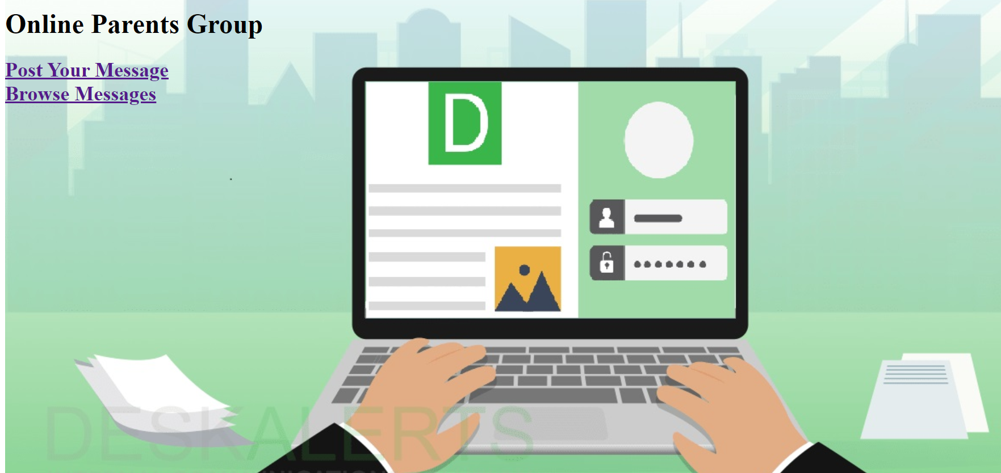
Home Page

Slide 13
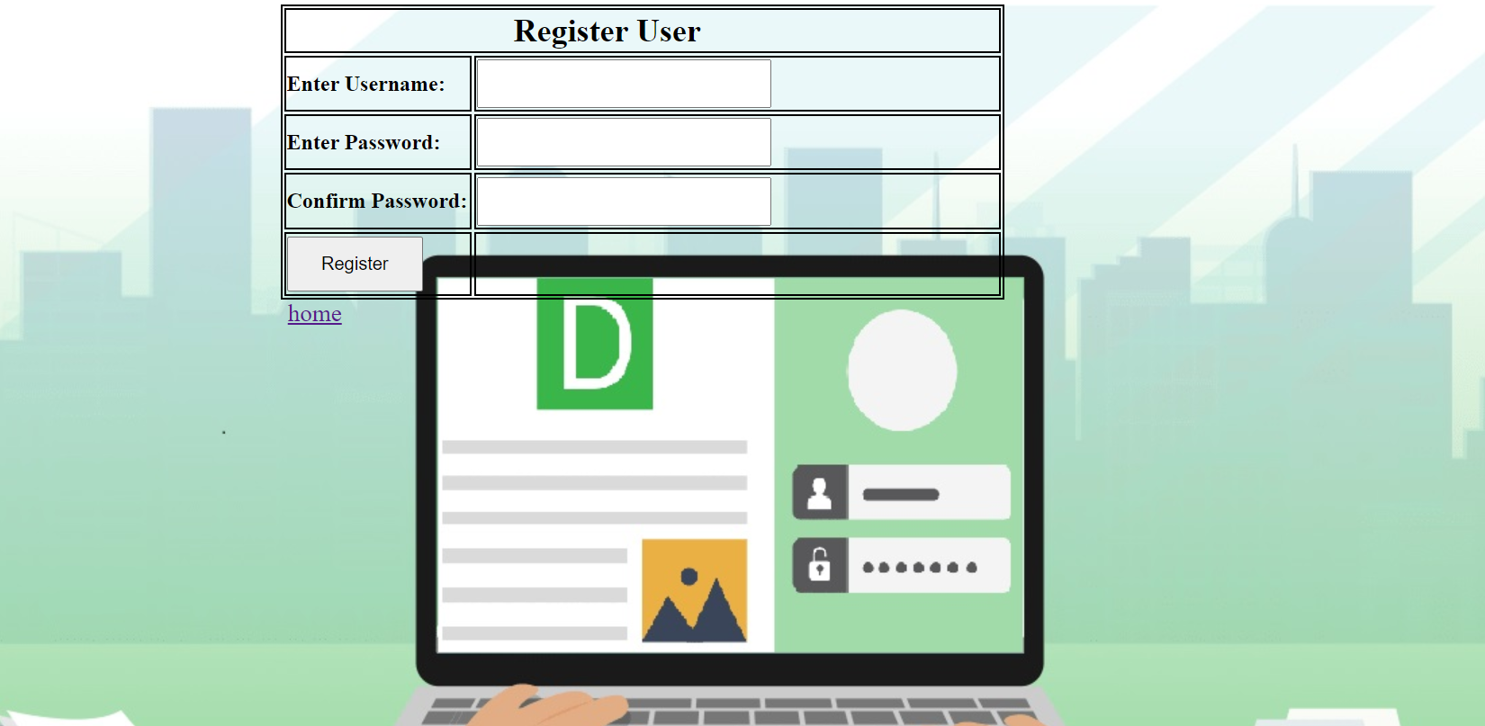
Register Page

Slide 14
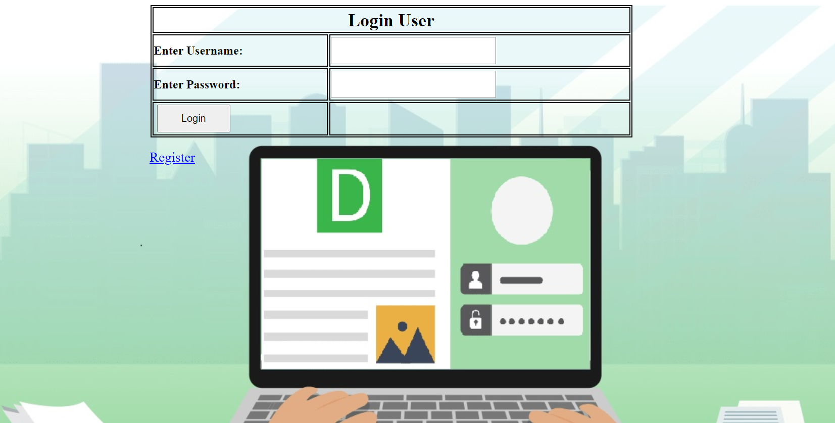
Login Page

Slide 15
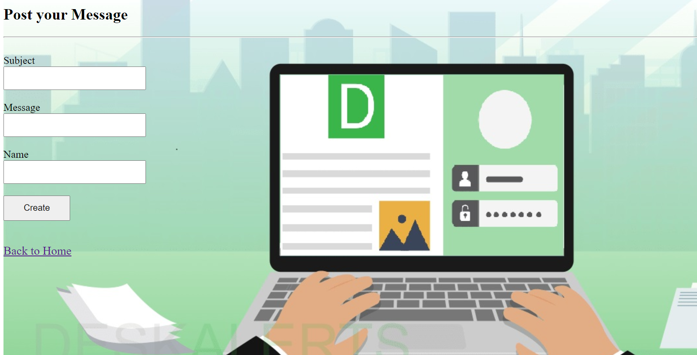
Post Messages Page

Slide 16
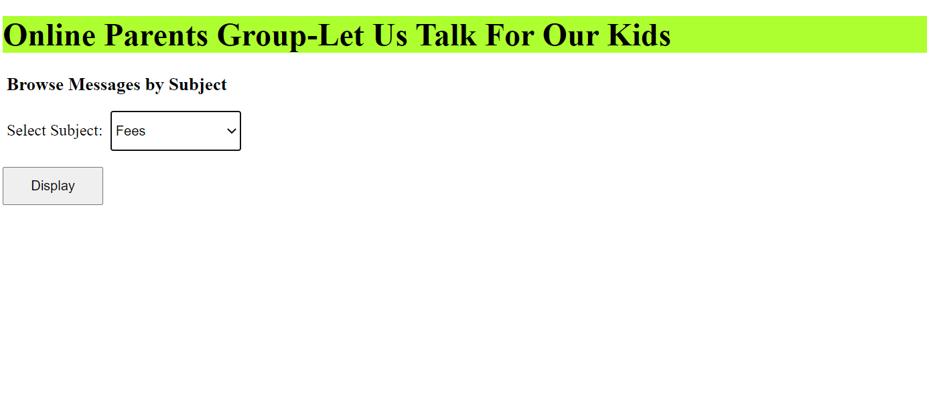
Browse Messages Page

Slide 17
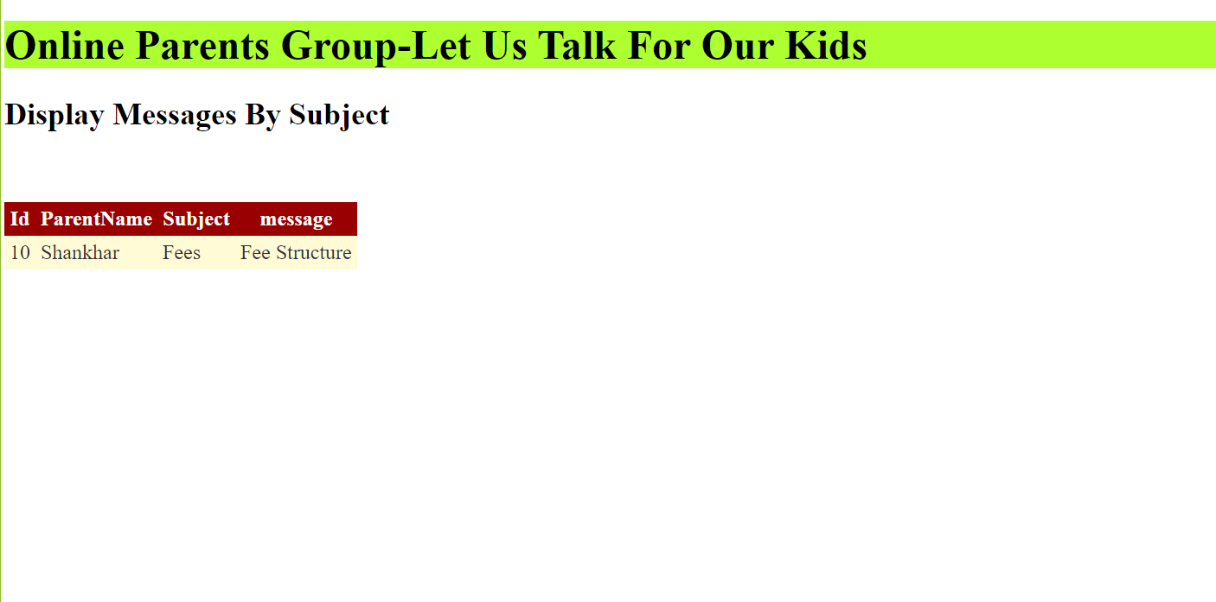
Display Messages Page

Slide 18
Future Scope
RFID Attendance/Biometric Attendance.
Study Material Delivery At Finger Tips.
Online Fee Payment.
Competition/Talent Contest Updates.
Test Questionnaire for Parents To Ask Students.

Slide 19
Conclusion
Making use of this Project, the Parents can share their ideas and messages with the School/ College Management regarding any Subject.
It can be used as a medium between the Parents and the Educational Authorities and we can develop this project as per our requirements.

Slide 20

Thank You
Please feel free to provide Feedback to help us improve.

